Slide 1
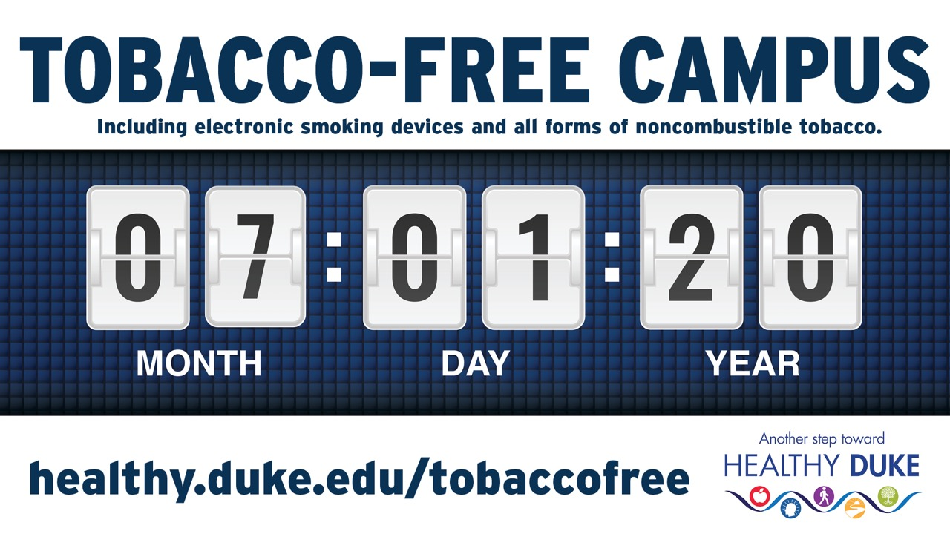

Slide 2
Tobacco-free policy
Duke University will be a tobacco-free campus beginning July 1, 2020. This means the use of all tobacco products will be prohibited at Duke University.
The policy will prohibit the use of all tobacco-based products, including cigarettes, cigars, cigarillos, hookahs, chewing tobacco, snuff, and electronic smoking devices such as e-cigarettes, vaping products, IQOS, as well as any other forms of tobacco.

Slide 3

Why?
Smoking is the leading cause of preventable death.
It leads to the death of more than half of all smokers.

Slide 4
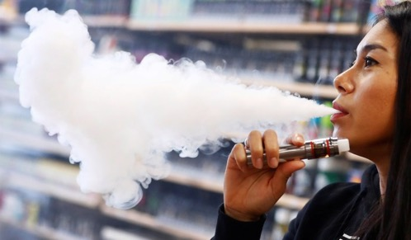
Why?
E-cigarette and vaping products have also been connected to an aggressive syndrome called E-cigarette, or Vaping, Product Use-Associated Lung Injury (EVALI).
Causes severe and sometimes fatal lung injury and commonly affects young people who are otherwise healthy.

Slide 5
Support and treatment
Smoking and nicotine dependence often require treatment to overcome.
  Tobacco Cessation Program
  NC QuitNow (telephone counseling)
  Prescribed Tobacco Cessation Aids
  Nicotine Replacement Therapy (over-the-counter)
  Prescription medications:
    CHANTIX, Bupropion, etc.

Slide 6

Who?
All students, staff, faculty, contractors, visitors, volunteers, and vendors on Duke University property are subject to the policy.

Slide 7
Role of managers
Inform: continue to make sure your staff are aware of this on-going initiative and the workplace expectations
Support: encourage smokers among your staff to make use of the tobacco cessation and other support resources available through Duke LIVE FOR LIFE, and their personal physician
Recognize: staff who have become tobacco-free as a result of their efforts and response to this change in workplace policy
Create and foster a "quit-friendly" environment: educate yourself and your staff about the cessation process and how to support those breaking free from tobacco. Engage former users as advocates.
Act responsibly: support the tobacco-free policy by holding all persons accountable, including staff, students, faculty, volunteers, visitors, vendors, and contractors. Managers are expected to encounter tobacco users, informing them of the policy & offering cessation resources.

Slide 8
Enforcement
Approach with compassion & evidence-based treatment
After the policy goes into effect on July 1, 2020, those found smoking will be referred for tobacco cessation treatment.
Those who do not engage in treatment and continue to smoke, vape or use tobacco on Duke property will be subject to the same established procedures for any policy violation.

